Slide 1
District-level male circumcision coverage, circumcision rates, and unmet need: spatio-temporal analysis of national household surveys
Jeff Eaton, Patrick O'Toole, Matt Thomas MRC Centre for Global Infectious Disease Analysis Imperial College London
Global and Regional VMMC Stakeholder Meeting, Kigali 12–14 September 2022

Slide 2
Objectives
Analyse national household survey data (DHS, AIS, MICS, PHIA) with self-reported male circumcision status
Outputs:
Number and percentage of men circumcised / unmet-need
Rates of medical and traditional circumcision over time
Annual estimates stratified by:
District
Medical / traditional type
Age group
Use small-area estimation methods to produce district-level estimates
Spatial smoothing of circumcision rates in neighbouring districts; over ages

Slide 3
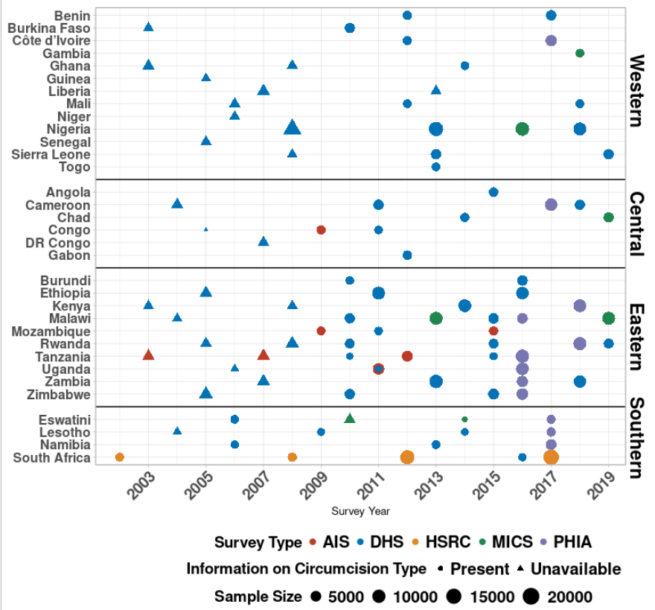
Methods – Data
120 household surveys (2002 – 2019) from 33 SSA countries
Major survey series (DHS, AIS, PHIA, MICS, HSRC in ZAF)
Individual-level data: self-reported circumcision status by male respondents
Respondents located to districts using cluster geocoordinates
Located to admin 1 (province) where coordinates not available (MICS)
VMMC programme data not used

Slide 4
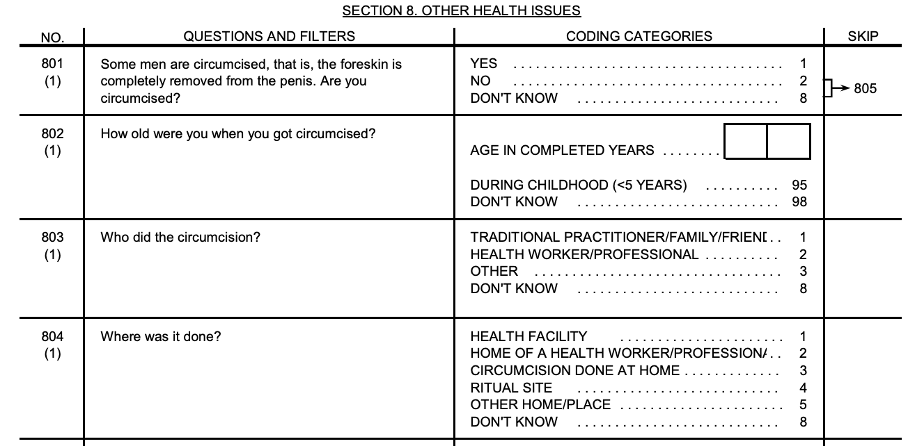
Household survey questions
Demographic & Health Surveys (DHS) / MICS
Circumcision status
Age at circumcision
Who conducted?
(Medical / traditional)
Where conducted?
(Medical / traditional)

Slide 5
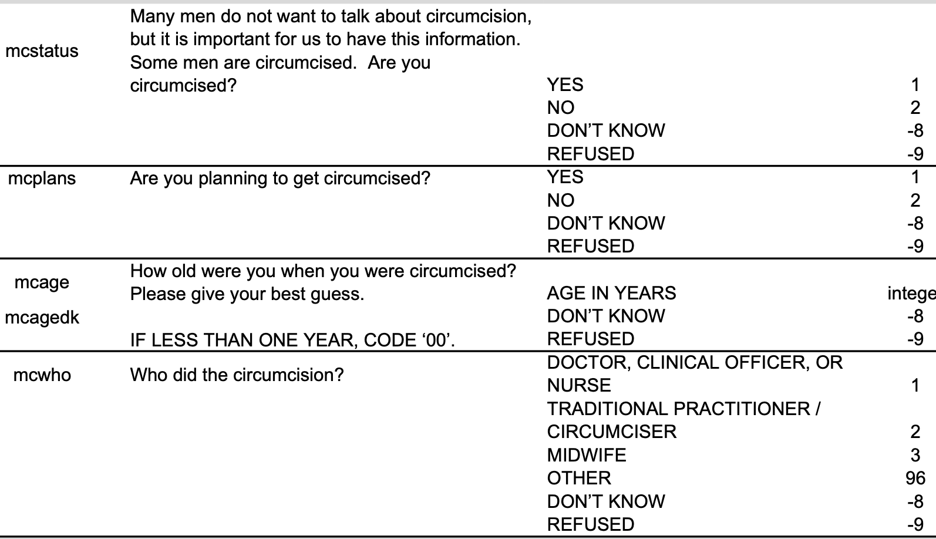
Household survey questions
PHIA surveys
Circumcision status
Age at circumcision
Who conducted?
(Medical / traditional)
[Setting where conducted not asked in most PHIAs]

Slide 6
Methods – Categorising MC Type
 |  | Circumcision Provider
 |  | Medical | Traditional
Circumcision Location | Medical | MMC | MMC
 | Traditional | MMC | TMC
Circumcisions performed by a medical professional and/or in a medical setting are categorised as MMC
Otherwise, circumcisions are TMC
Where no data is present on location or provider, circumcision type → Missing

Slide 7
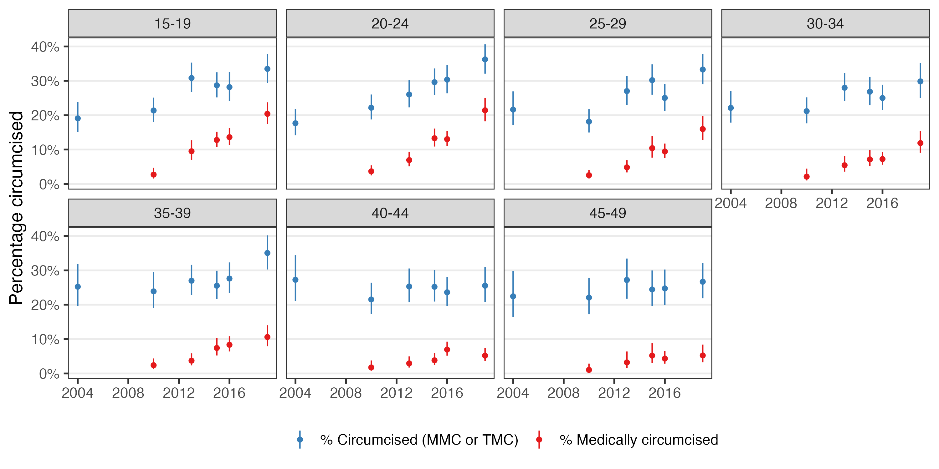
Surveys: coverage by type and age
Malawi: circumcision coverage by type and age group—survey estimates

Slide 8
Survival analysis framework for survey data
Age
30
Individual-level household survey data provide direct estimates of circumcision rates over time and by type for years preceding survey
→ Direct estimates of TMC practices, age at circumcision, VMMC impact
Respondent aged 28 at survey in 2017
Reported traditional circumcision at age 16
→ TMC in year 2005
0
2017
Year

Slide 9
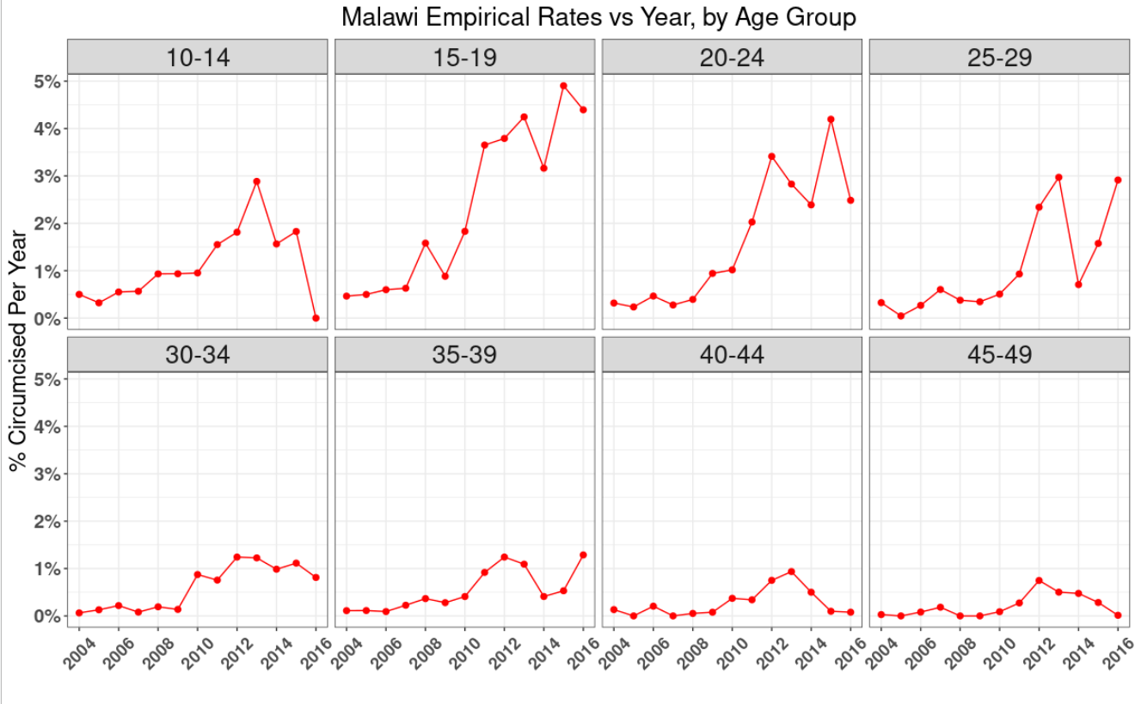
Estimates of circumcision rates

Slide 10
Methods – Model (“threemc”)
Bayesian spatio-temporal, competing-risks, time-to-event model (threemc)
Model stratified by:
Age
District
circumcision type (traditional / medical)
TMC & MMC rates estimated (by age, district, and time)
Spatial smoothing allows for district level estimates
Circumcision coverage since most recent HH survey: projected assuming continuation of estimated age-specific rates, with probabilistic uncertainty
Important assumption: TMC rate assumed constant over time
Notes:
Time-varying rate of MMC estimated from survey

Slide 11
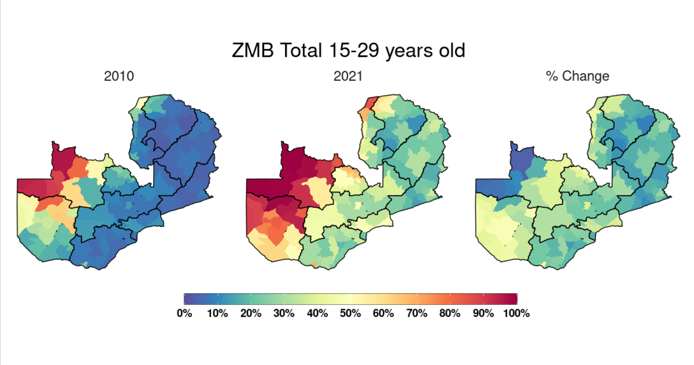
Results – Zambia (MMC & TMC)
Notes:
ZMB had highest district-level discrepancy in MC coverage (Mungwi (0.0884) vs Mwinilunga (0.996))
Note how MMC for ZMB has increased in regions where TMC is not generally practiced, and also how TMC seems to have slightly decreased in some regions, may point to conversion of TMC to MMC-T in the region (here we've had to assume all MMC was MMC-nT, and vice versa for TMC)

Slide 12
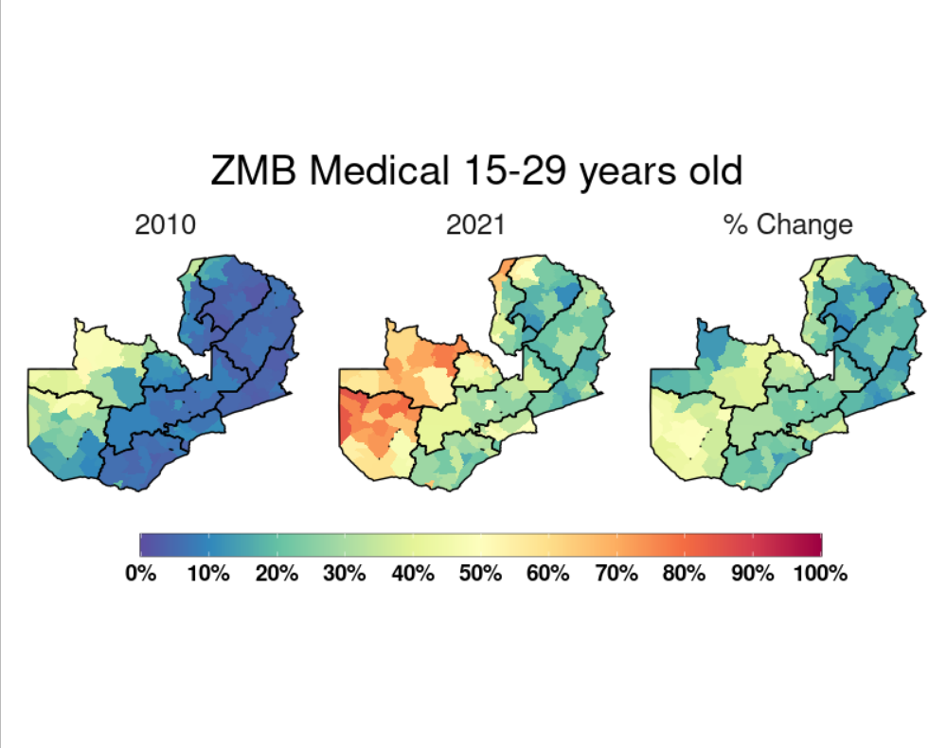
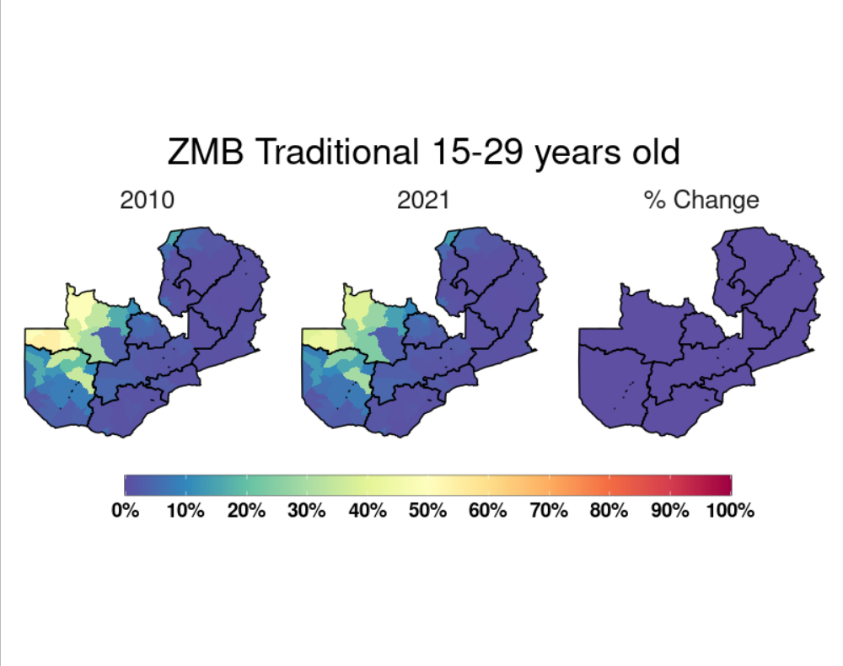
Results – Zambia (MMC & TMC)
Notes:
Note how MMC for ZMB appears to have increased in regions where TMC is not generally practiced, and also how TMC seems to have slightly decreased in some regions, may point to conversion of TMC to MMC-T in the region (here we've had to assume all MMC was MMC-nT, and vice versa for TMC)
However, still increased by quite a bit in North-Western & Western Provinces!

Slide 13
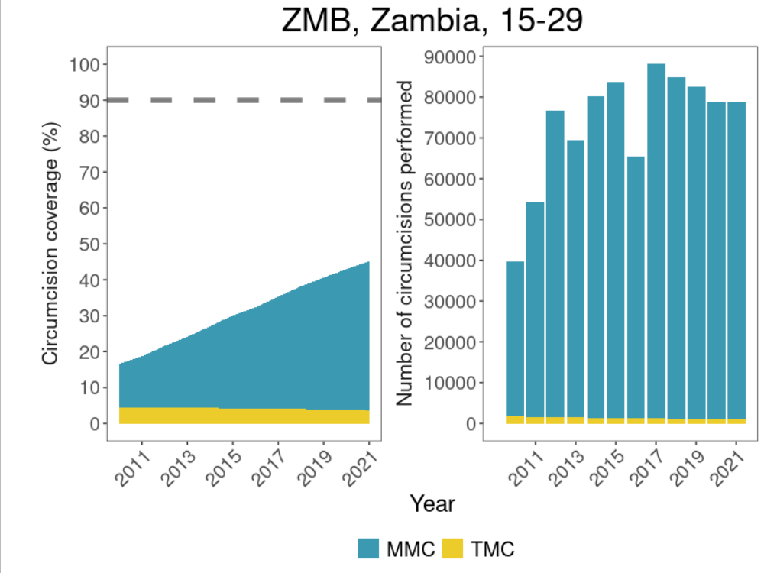
Zambia: Coverage & Circumcisions Performed
Large increase in circumcision driven by medical circumcision
Nationally, far from 90% coverage target, based on projection from last survey (2018)

Slide 14
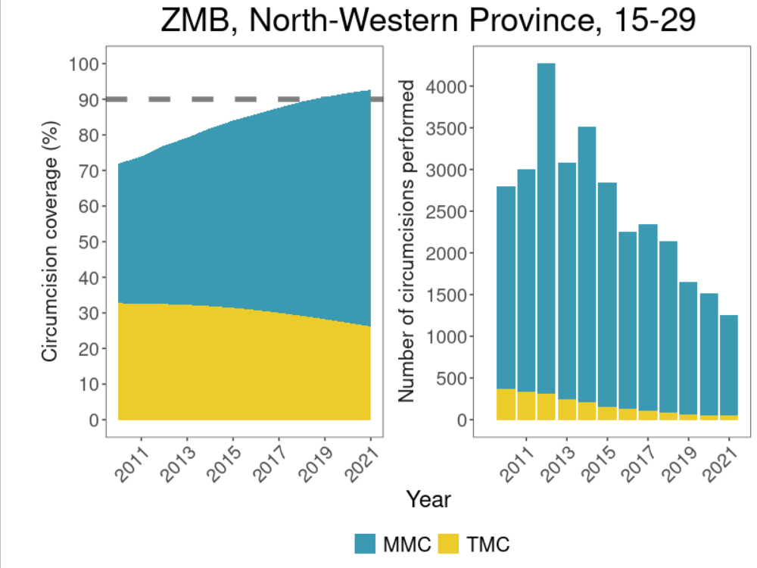
Subnational results
Decreasing traditional circumcision in some regions
"Competing events" nature of model
Higher rates of MMC before TMC occurs
Large VMMC uptake in province with relatively high traditional circumcision
Note: do not currently estimate ‘replacement’ of TMC by MMC (model limitation)
Notes:
Blue region "encroaching" on yellow region is likely MMC-T

Slide 15
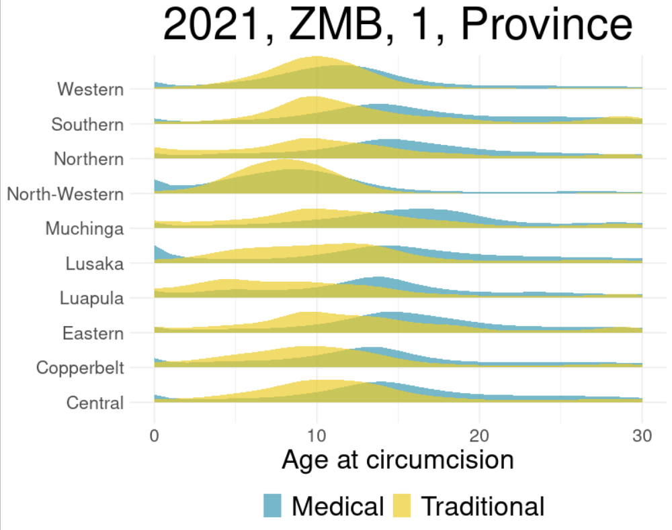
Zambia: Distribution of age at circumcision in 2021, by province
Age at circumcision younger for traditional circumcision (around 8-10 years) than medical circumcision (14-16 years)
Contribution of ‘at birth’ MMC in some locations—e.g. Lusaka (non-VMMC programme)

Slide 16
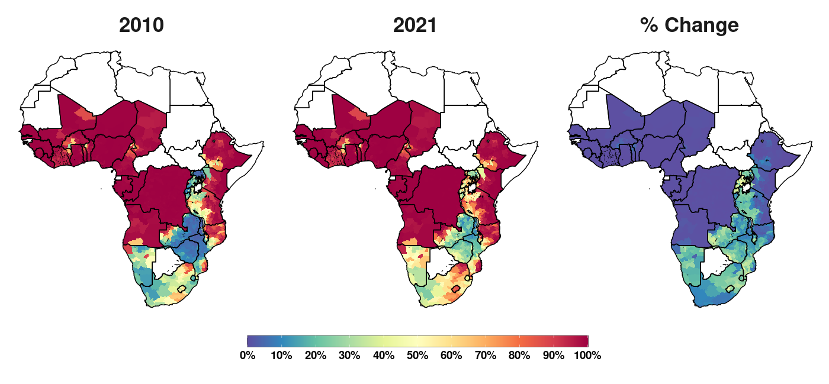
Results – Total Circumcision (15-49) Change since 2010

Slide 17
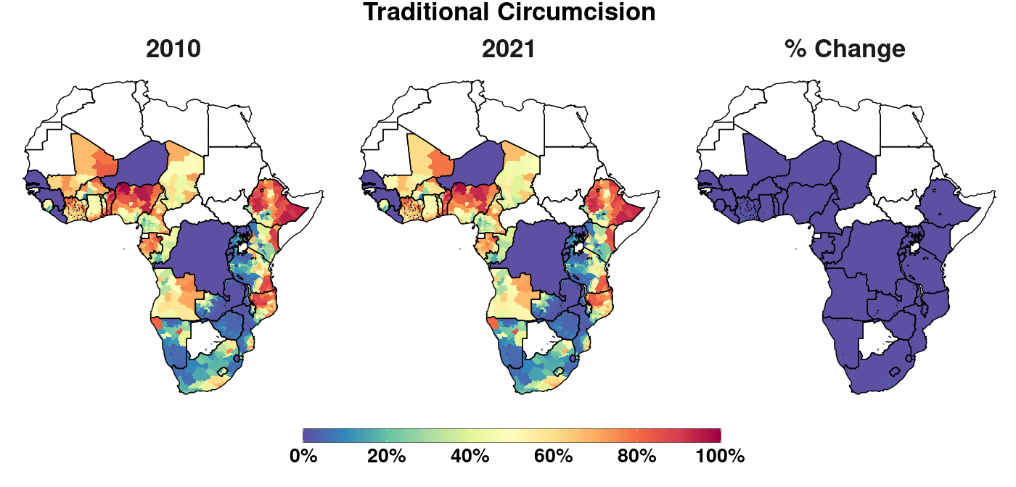
No change in traditional circumcision from 2010 to 2021 (model assumption)

Slide 18
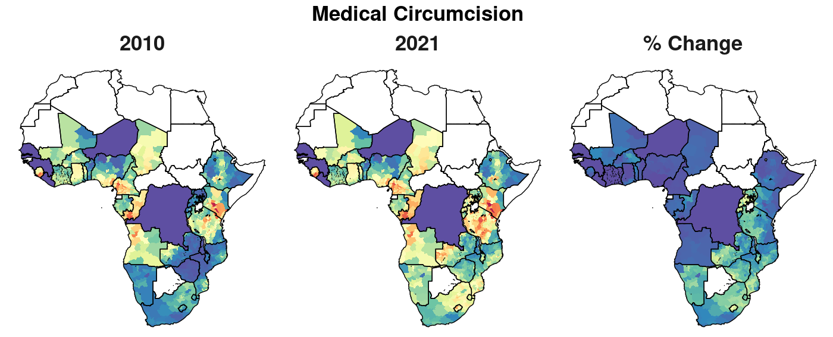
Increase in MC driven by MMC through VMMC programme implementation
Concentrated in ESA, where TMC less widely practised

Slide 19
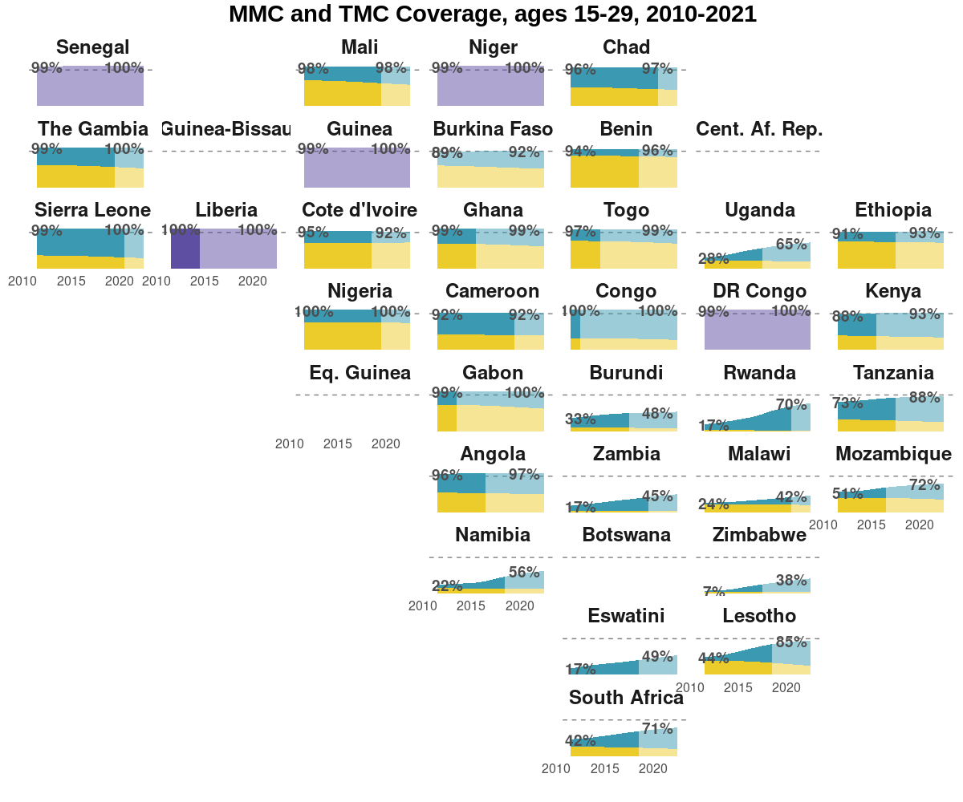
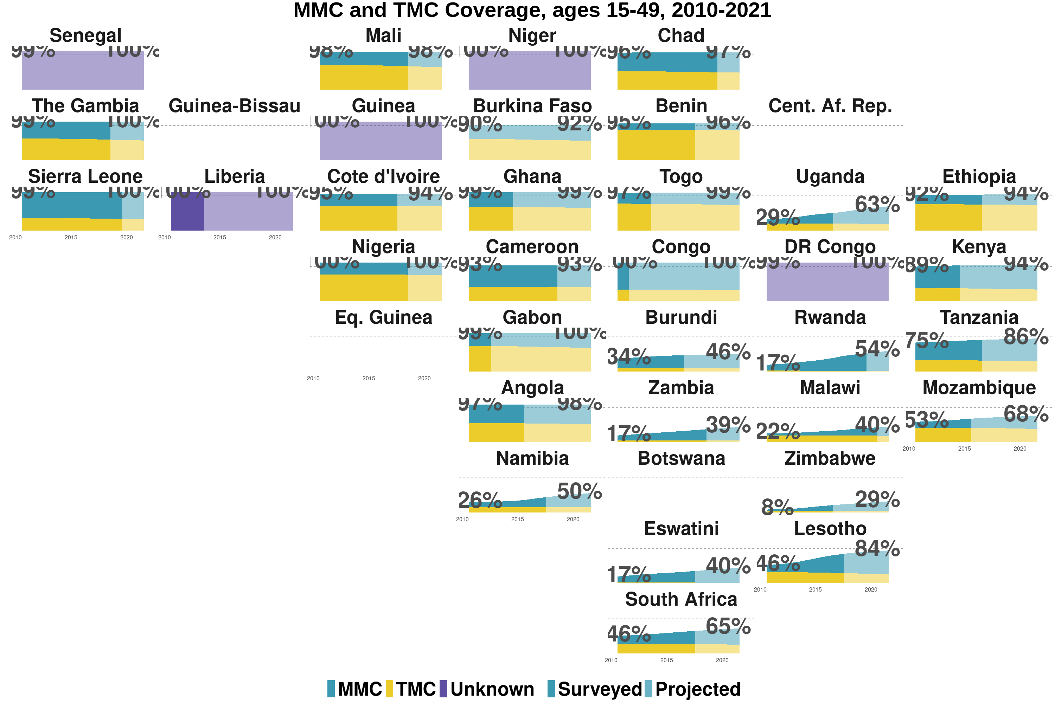

Slide 20
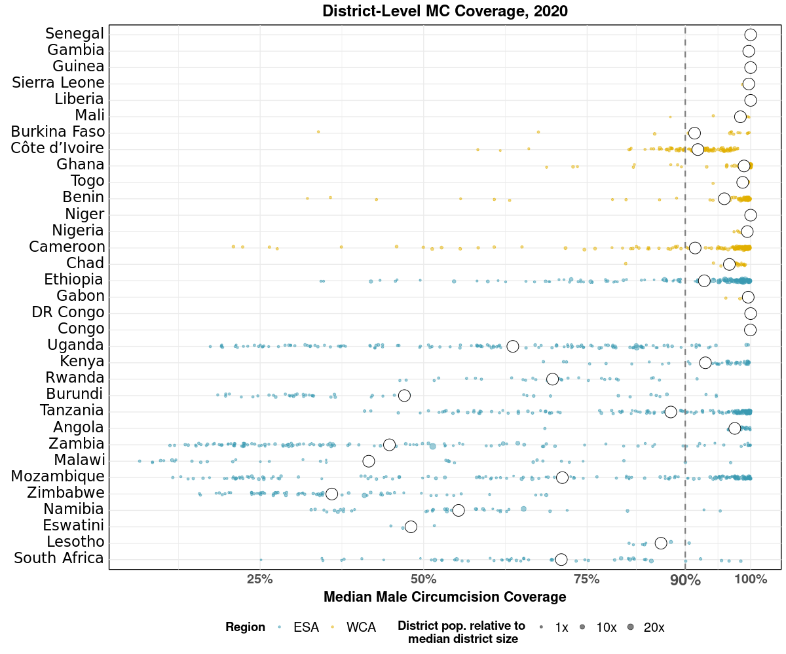
Subnational variation: Circumcision coverage by district in 2020
Notes:
Substantial district level variation within countries
Appears to be higher for ESA than WCA
Each point is a district, sized by district population relative to average district size and coloured by the African region their country falls under (Eastern and Southern Africa (ESA) and Western and Central Africa (WCA), respectively). Each white dot represents the national median. A vertical dotted line signifies the UNAIDS target of 90% national MC.

Slide 21
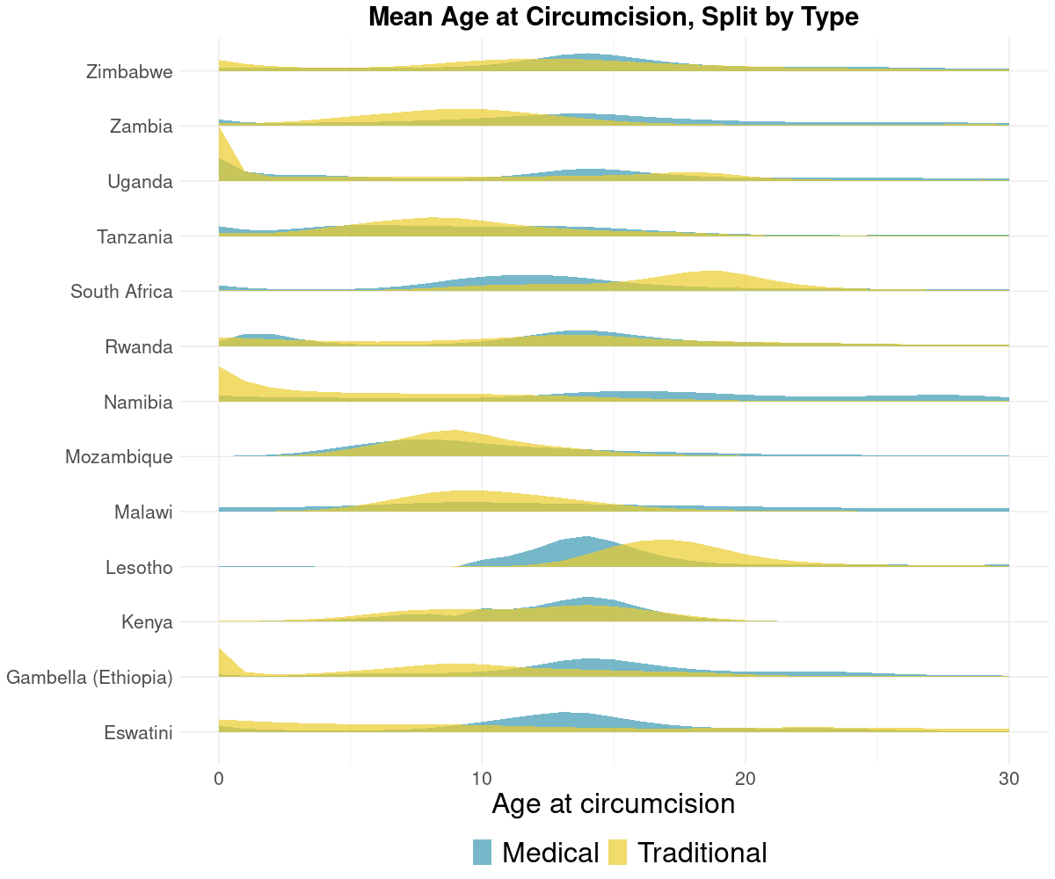
Distribution in age at circumcision, by type Variation across countries in traditional practices
Notes:
Mean age at circumcision varies substantially among 14 VMMC priority countries

Slide 22
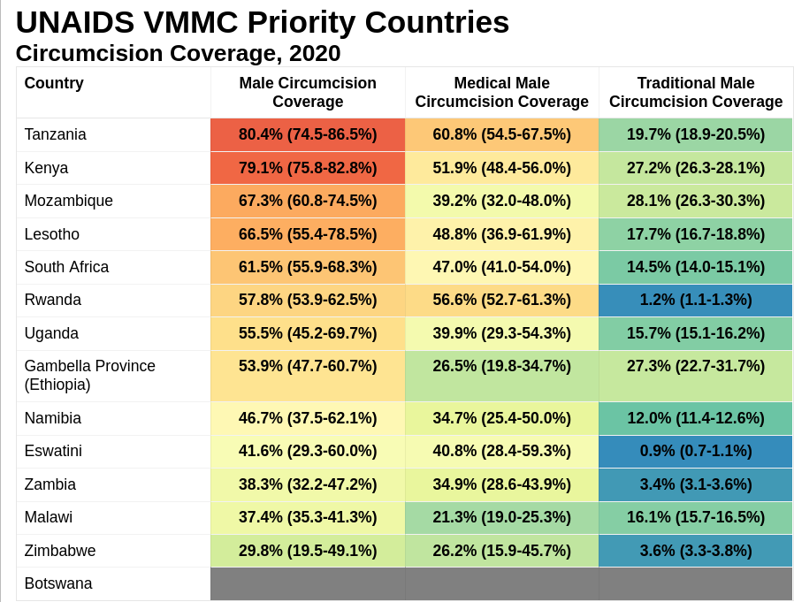
No VMMC priority countries estimated to have reached 90% circumcision coverage by 2020.
19m MCs performed on 10-29 year olds in these countries from 2010 to 2020.
20m additional MCs required to reach 90% in priority countries.

Slide 23
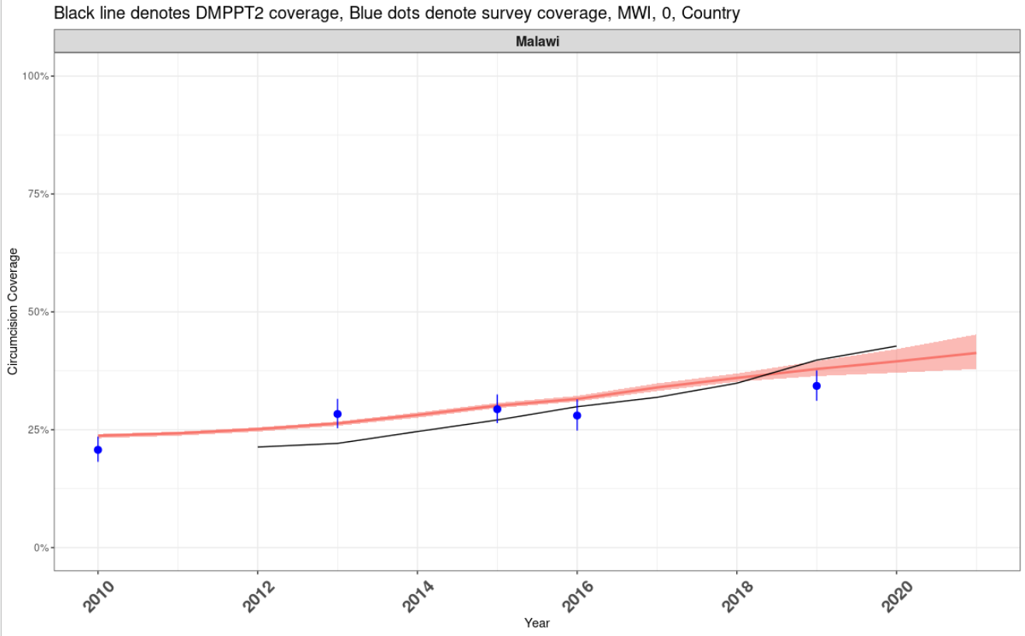
Comparison with DMPPT2 Results
Relatively consistent results at national level in most countries
Countries for which models generally agree:
Malawi (shown here)
Kenya
Namibia
Eswatini
Mozambique
Notes:
MOZ

Slide 24
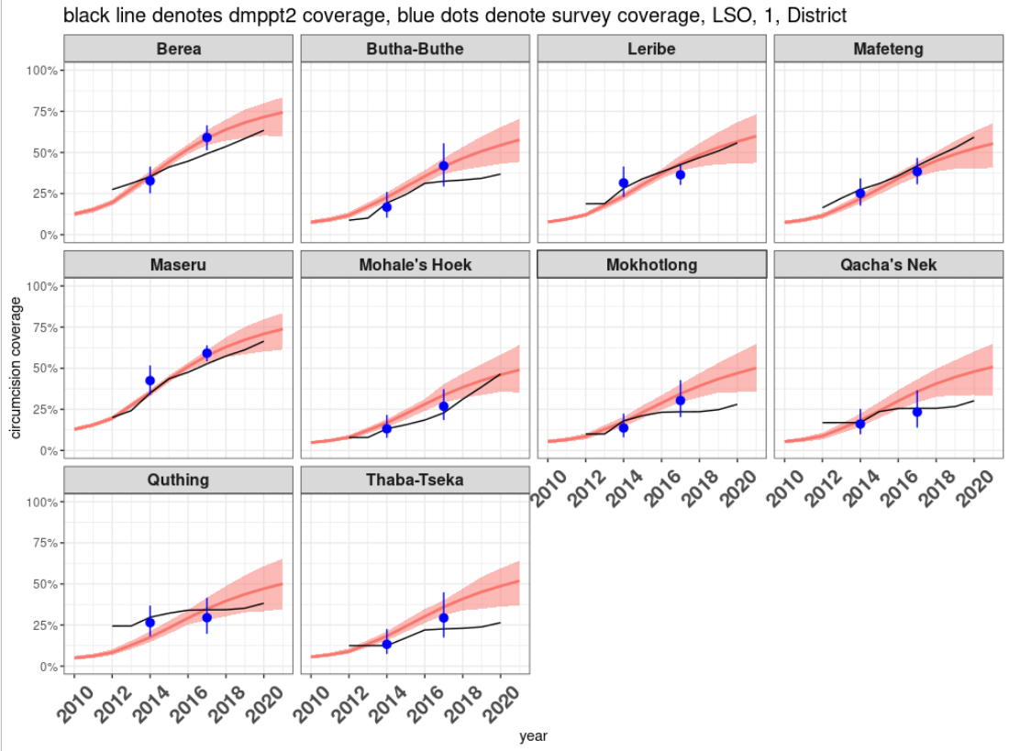
Comparison with DMPPT2 Results
Lesotho: Survey model (last survey 2017) much higher than DMPPT2 coverage
Notes:
LSO

Slide 25
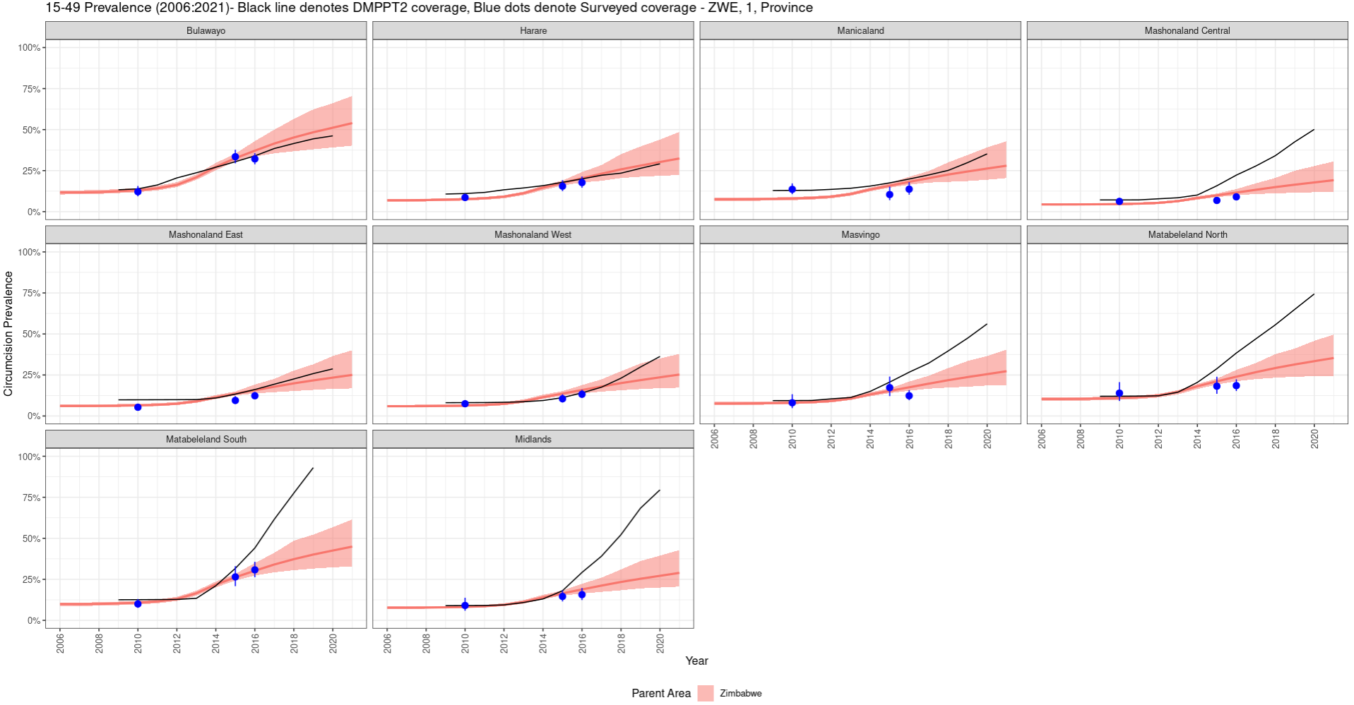
DMPPT2 Comparison — Zimbabwe
Similar national levels, but differences in some regions
Zimbabwe: nationally similar, but last survey was in 2016 and since then some provinces have seen extremely high increase in MC (presumably MMC) in DMPPT2 results
Notes:
Last survey for ZWE was in 2016, so it is conceivable that VMMC has ramped up as DMPPT2 suggests

Slide 26
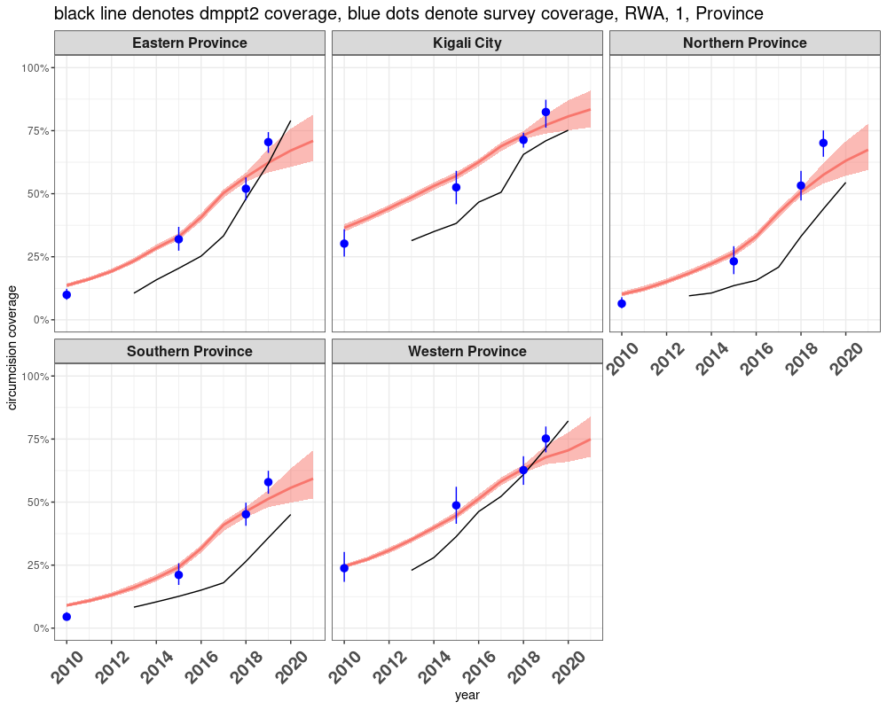
Results – DMPPT2 Comparisons - Rwanda
Rwanda: Survey model systematically higher than DMPPT2 coverage, although converging for latter years
DMPPT2 captures (relative) increase in 2019+ MC, threemc does not
Notes:
May be that baseline for RWA is incorrect, as slope for DMMPT2 seems relatively accurate
Last survey for RWA was in 2019
DMPPT2 captures "signal" from last survey, while our model doesn't seem to do so!

Slide 27
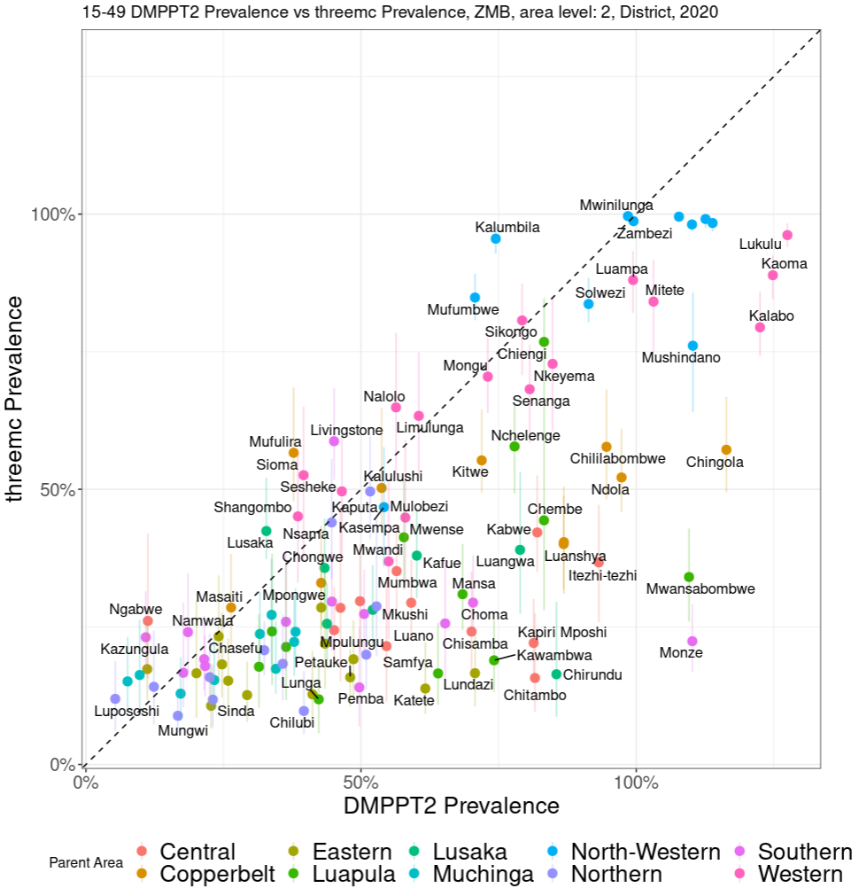
DMPPT2 Comparisons — Zambia
Survey model: less extreme variation between neighbouring districts
Zambia: DMPPT2 generally higher than survey model in recent years
Suggests inputted number of circumcisions far larger than surveys suggest
Several districts with >100% coverage
Notes:
some regions have > 100% circumcision, could be that our population for the region is wrong, but more likely that people are travelling from other regions to here for circumcision, and/or the VMMC data has been misreported

Slide 28
Challenges and limitations
Inconsistent MC self-reporting by same cohort in successive surveys
E.g. in 2017 survey, men 30-34 report higher % circumcised in 2012 than ‘same’ men age 25-29 in 2012 survey
Affects circumcision level, and distribution by type
‘Replacement’ of traditional circumcision by medical circumcision
Evidence of this in surveys from several countries; work in progress
Also not fully accounted for in DMPPT2 baseline coverage inputs
Surveys imply different level of scale-up than programme data
Several countries: surveys suggest fewer VMMCs conducted than programme data

Slide 29
Summary: threemc
Model provides outputs for
Circumcision coverage and unmet need
Circumcision rates by type
Age at circumcision distribution
Similar structure as DMPPT2; focuses on different data for estimates
Statistically calibrated with all available household surveys
DMPPT2: focuses on district/age-level VMMC programme data
Results may be useful for comparison with DMPPT2 results, inputting as baseline rates / coverage in DMPPT2
May provide useful ‘unmet need’ targets for challenging districts in DMPPT2
Limitations: relies on extrapolation since most recent survey
Does not incorporate location-specific programme data
Work in progress to combine programme and survey data: South Africa, Malawi examples

Slide 30
Thank You! Any Questions?

